Slide 1
As featured on
Personalised insurance
The Digital Insurer Europe Conference

Slide 2
Overview
FitSense’s data platform allows people to use their online personal data to obtain more personalised insurance products, special rates and a better customer experience.

Slide 3
Opportunity
Nearly 60% of consumers collect personal data through mobile apps and connected devices.
Intelligently combined this data provides deep insight into people’s personal lifestyle and specific needs and wants.
SOCIAL
HEALTH & FITNESS
CONSUMER MEDICAL
70% penetration
30% penetration
5-10% penetration
>50% active monthly users
25% active monthly users
~30% active monthly users

Slide 4
Generic Insurance Products
People are offered insurance products that are highly unspecific to the individual’s needs and personal lifestyle
Why insurance?
Current problems with life & health insurance
Unfair Premiums
Many people overpay for their insurance premiums as lifestyle factors are not adequately reflected
Outdated Application Process
Application process is outdated, complicated, and prone to mistakes

Slide 5
PLATFORM
Personalised Products
Improved Underwriting
Continued Engagement
1
2
3
Data Collection
Our data platform integrates with a wide range of popular apps and devices
Profiling
Our algorithms turn this data into insurance specific customer profiles
Integration
Our software takes this information straight into the customer journey

Slide 6
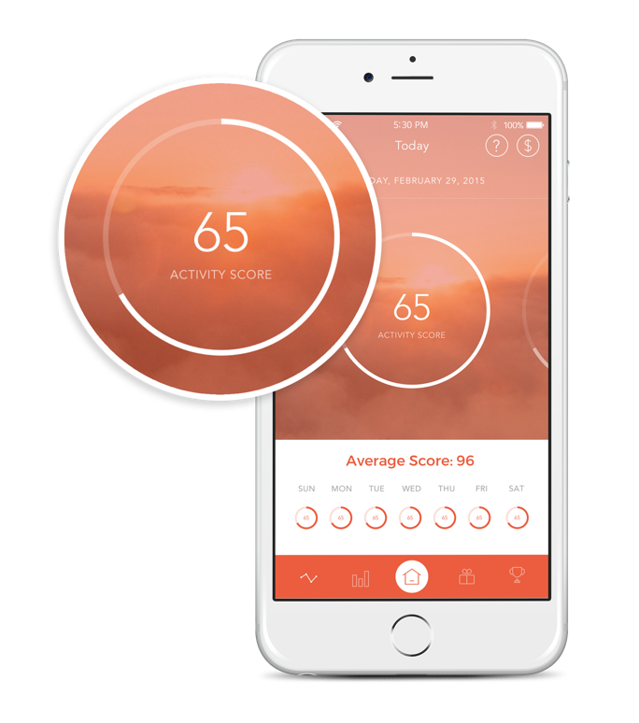
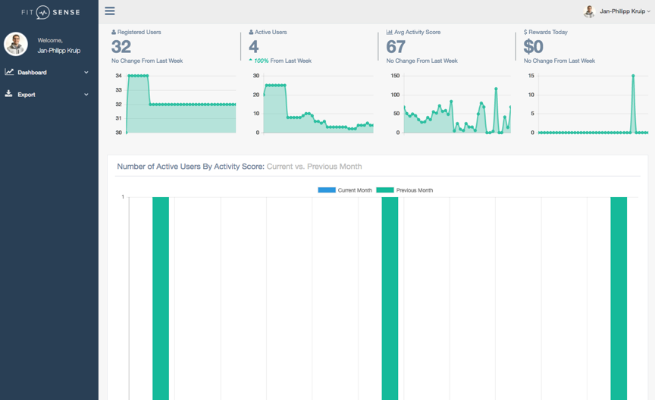
PRODUCTS: HEALTH ENGAGEMENT APP
Plug & Play rewards programme
API
White-label mobile app available for iOS & Android and compatible with all major activity trackers including the built-in activity tracker of selected mobile phones. Maximum reach. Your brand.
Web administration dashboard to track progress, manage rewards and interact with customers. Full control and an effective marketing tool.
API to access customer data and insights without technical and regulatory complexity of handling high volume of app and device data. Full data access. Low complexity.
Customer support in local language for mobile app. Maintenance of mobile app, web dashboard and API services. Less operational complexity. Lower costs.

Slide 7
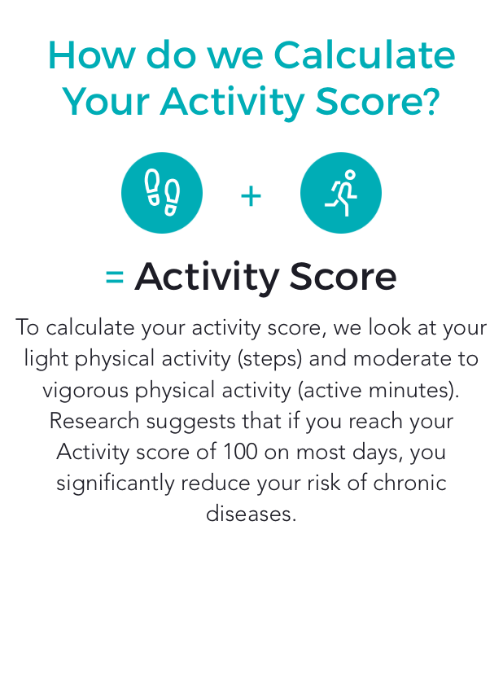
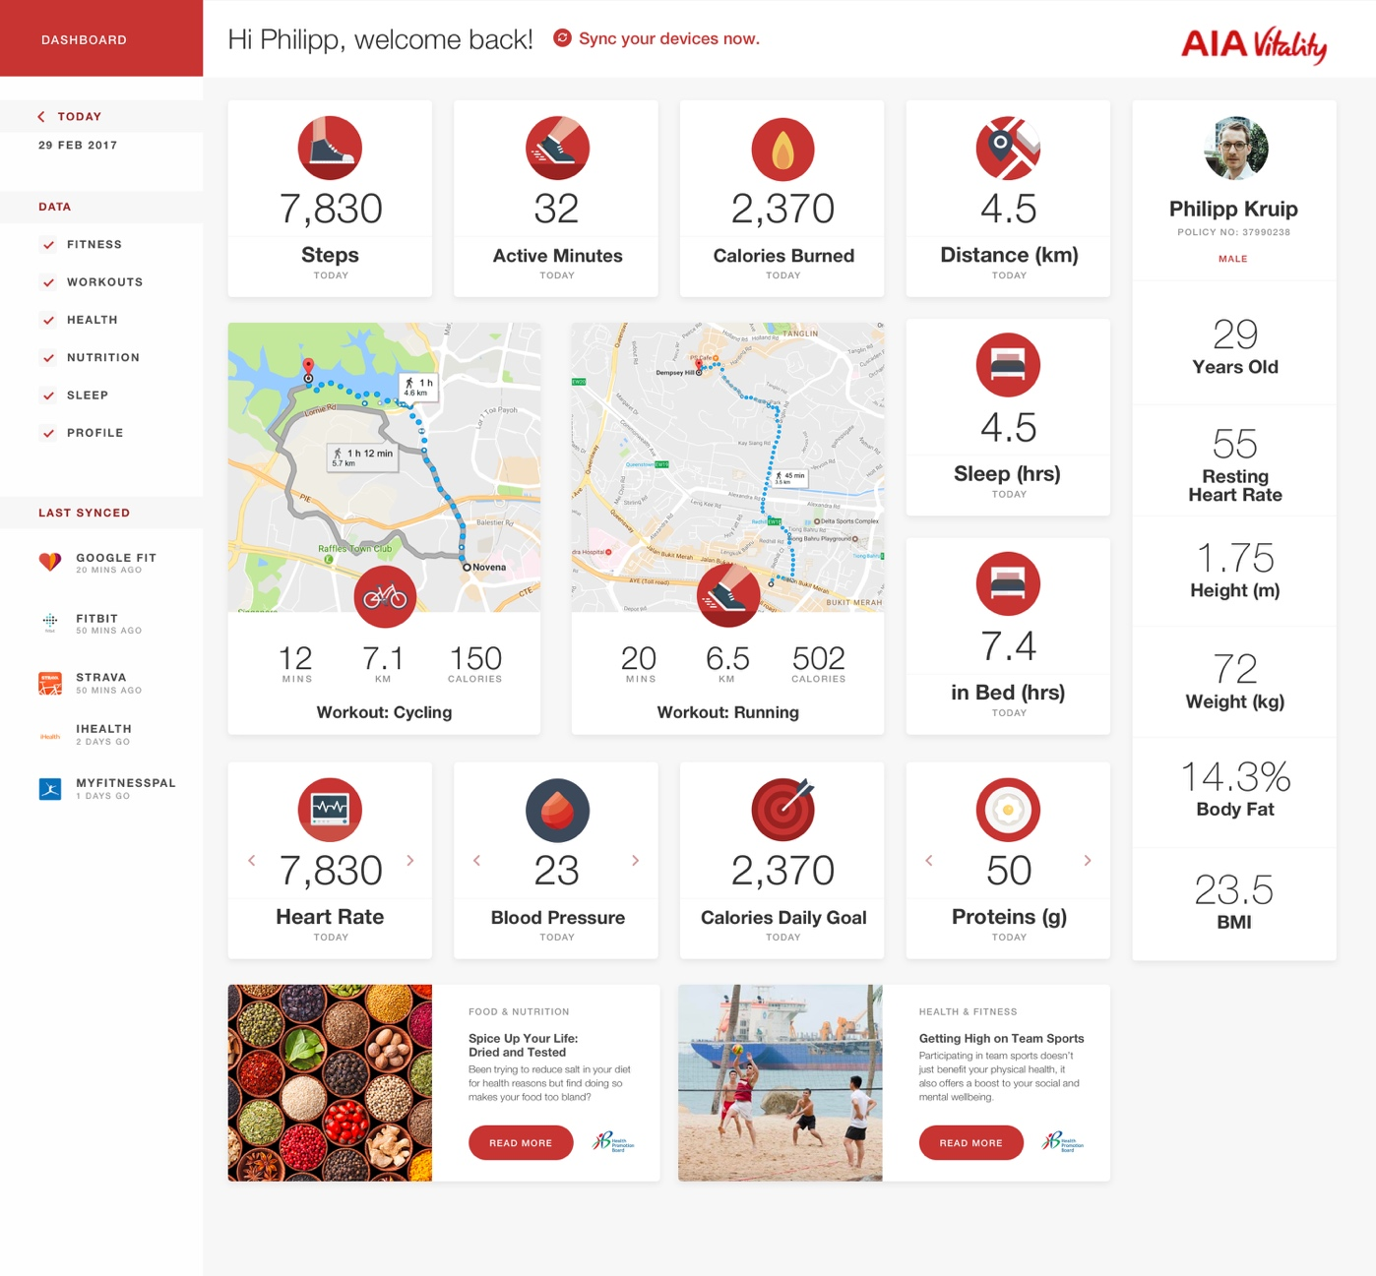
PRODUCTS: API Services
Access to multiple apps and devices with a single API
App & Device Integrations
Data Standardisation
Data Visualization
We connect to the most popular health & fitness apps and devices and provide a single API. We maintain the integrations and ensure compliance with regulation and security standards.
We standardise data across apps and devices to give comparable, insightful and actionable metrics.
We provide white-label customisable user dashboards to visualise user data in an engaging way.

Slide 8
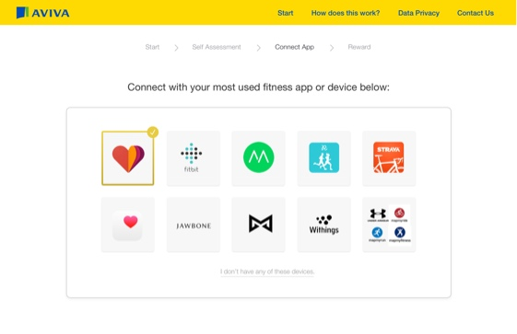
PRODUCTS: UNDERWRITING & PRICING
Dynamic and efficient underwriting process by identifying low risk groups of past or present diseases based on an external data profile
1
THE MODEL
2
VALIDATION
Cluster 1
Cluster 2
Cluster 3
External Data Collection
Physically active
Good work / life balance
+
High spending power
Application & Claims Data
High level of education
Data profile indicates low risk for past or present disease
Data profile indicates normal risk for past or present disease
Data profile indicates increased risk for past or present disease
Shortened application form with “catch-all” questions
Traditional
application form
Extended
application form

Slide 9
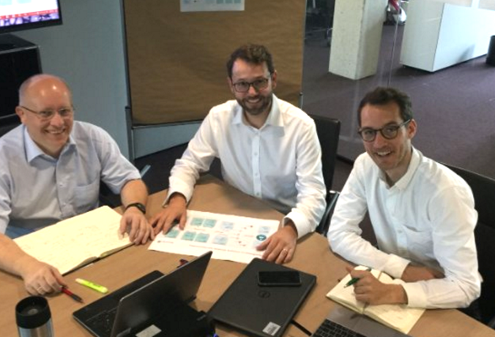
Selected for Accelerators
Winner MAS Global FinTech Hackcelerator
Traction
Strategic Partnership with Munich Re
Existing Projects with (Re)-insurers

Slide 10
Team
Alvaro Gauterin
Jan-Philipp Kruip
Tom Samodol
CO-FOUNDER, CTO
CO-FOUNDER, CEO
INTERIM COO
Software Engineering
Finance, Consulting
Experienced COO
advisors
David Dean
Paul Stacy
Philip Proost
Previously Senior Partner at BCG
Founder Wunelli (acquired by LexisNexis)
Previously CIO at Catlin (now XL Catlin)

Slide 11
As featured on
✶ fitsense.io
 jp@fitsense.io
 FitSenseHQ

