Slide 1


EVENT BASED
INSURANCE MADE EASY
THE DIGITAL INSURER
EUROPE 2017 NOMINATION
15.05.2017
POWERED BY
SituatiVe GmbH | Lennart Wulff | Duesseldorf

Slide 2

80%
Say that they would buy insurance for events that are not covered within current insurance policies.

Slide 3









Numerous Events where we’ve got you covered already!!
But more to come

Slide 4
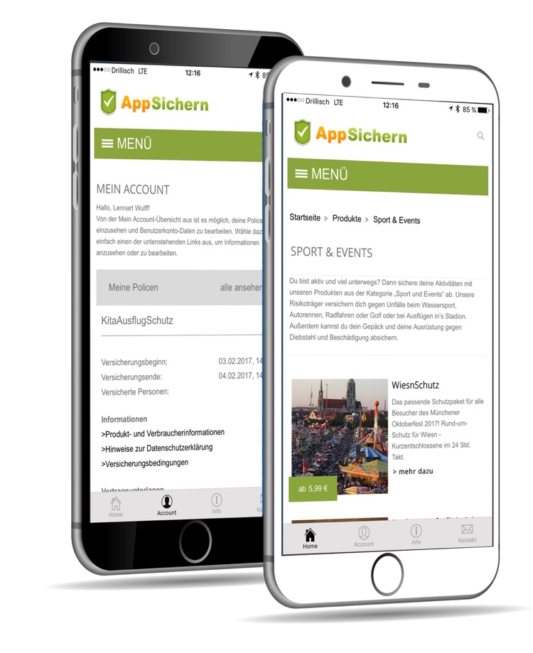
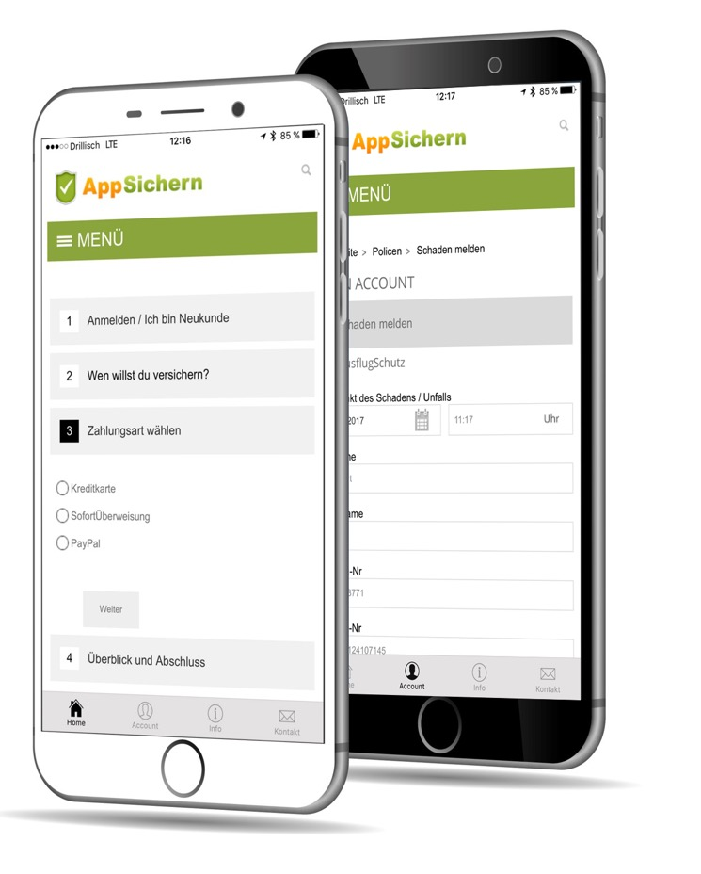

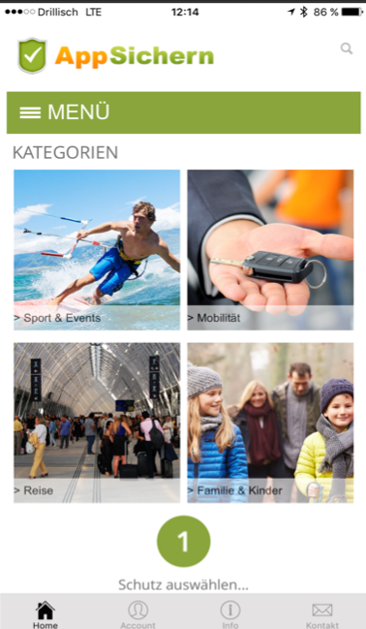
OUR PRODUCT
EVENT BASED INSURANCE MADE EASY
CONTRACT MNGT.
CONFIGURATION
SELECTION
PAYMENT
CLAIMS

Slide 5

USP: Explicitly tapping into four key millennial trends
1
2
Don’t lock me into a lengthy contract.
On-demand
^{No.}
^{No.}
3
4
People / agent optional
Unbundled convenience
^{No.}
^{No.}
Notes:
Source: http://www.digitalinsuranceagenda.com/79/the-power-to-insure-what-you-want-when-you-want-it/

Slide 6




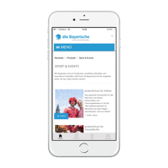



OUR SETUP
DIGITAL INSURANCE INTERMEDIARY
Product Development
Fullfilment Processes
Distribution Tech
Marketing Processes
Product Selection
Sales
Payment
Documentation
Claims Settlement

Slide 7
HOW IT ALL CONNECTS
MOBILE
Customer uses mobile device / wearable / IoT for engagement
24 / 7
Digital end-to-end service allows self-service anytime, anywhere
EVENT TRIGGER
Products align to specific target group demands, e.g. festivals, sports events, that are out of scope of the routine risk scenario
PERSON / AGENT
Trust connection, facilitator of new product initiatives, gains more touchpoints and insights via behavioral data
PARTNERING
X-industry Partners with massive customer engagement want new content / offerings from insurers
GEOFILTER
Content appears on news feed / display ONLY where it specifically makes sense

Slide 8

LESSONS LEARNED
1
Complement existing Products!
^{No.}
2
Don’t burden existing legacy systems!
3
^{No.}
Focus & Deep Dive on Customer Journey!
^{No.}

Slide 9

VALUE CHAIN
DIGITAL END-TO-END AT LOW COST
Customer
Risk Transfer
Insurer
Product design
Event with inherent Risk
Platform
Digital Onboarding of products
Event based product provision
Problem
Product Definition
Mapping of pricing logics
Self-service product selection
Setup / templating of documents
On-Demand-Decision
Options
Payment processing
Digital Distribution
Stress free purchase and payment
Ongoing admin & claims settlement
Immediate approval & processing
Digital claims regulation
Solution
Digital administration
After Sales Service
Reporting / Analytics
External Partnering

Slide 10






TRACTION TO DATE
Let’s
talk!
READY TO SCALE
+25 UNIQUE PRODUCTS
From 24 h up to 1 year
Prices from 1,5 to 3.000 $
Strong Partners,
+ 25 insurers
+ 500 distribution partners
+ 100K Customers
60 % customer retention rate
+ 15 paying white label customers
Great Project Pipeline,
+ 10 top brands
5 countries abroad lined up
∅ 25 % Revenue per Transaction
CAC < 8 $ per customer
CAC recovery in less than 3 months
Bootstrapped
Monthly burn rate < 10k $
All cash into tech

Slide 11

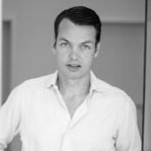

THANK YOU FOR YOUR ATTENTION.
EVENT BASED INSURANCE MADE EASY
Lennart Wulff
Founder
+49 151 24107145
lw@situative.com
Conrad Redlich
CTO
+49 172 9707160
cr@situative.com
www.situative.com

Slide 12

Copyright
The ideas listed in this document, ideas, concepts and advertising materials are property of SituatiVe GmbH and are subject to applicable copyright laws. The realization of ideas and related approaches is possible only with prior contractual agreement with the owners. The whole or partial reproduction and any disclosure to third parties is prohibited. The recipient of this concept is liable for the unauthorized use or disclosure to third parties and any damage arising therefrom . The recipient of this concept confirmed by receipt of the concept to maintain confidentiality and absolute silence about the ideas and proposals set out therein. Furthermore, the beneficiary shall already pay a market license or consulting fee in the case of partial realization of parts of the concept . If no agreement can be reached on the royalty sum, the recipient agrees on an arbitration by German Chamber of Commerce auditors / experts.
Jurisdiction is Düsseldorf, Germany.
SituatiVe GmbH
Margaretenstr. 4 - 40235 Duesseldorf - Deutschland T +49 (0) 211 749 58 778 E info@situative.com I www.situative.com

