Slide 1

Digital Agent Of The Future

Slide 2
General has a massive physical distribution network
70,000 agents around the world
2

Slide 3










But the world has gone digital
3
PRE-PURCHASE
PURCHASE
POST PURCHASE
On average 4 out of 5 touchpoints in customer journeys are digital

Slide 4
Agents need to adopt to digital (r)evolution
4
4

Slide 5


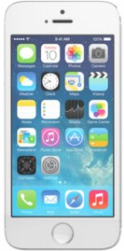
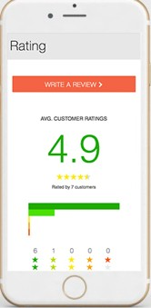
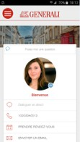
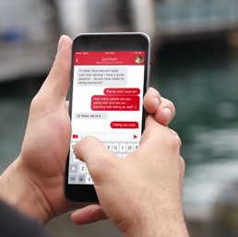
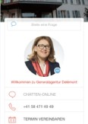


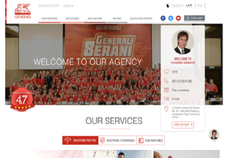

Generali Digital Agent enable OmniChannel Agent serve todays OmniChannel Client
5
Step 4
Learn & Engage
Step 5
Review & Refer
Step 3
Reach out
Step 1
Discovery
Step 2
Research & Validate

Slide 6
Traditionally Silos, Analog, linear mainly oﬄine communication
6
Generali
Agents
Clients

Slide 7




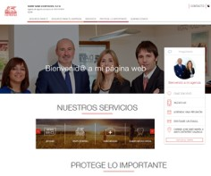
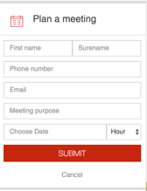
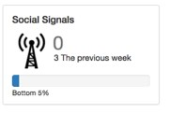

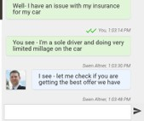
Digital Interactions will help connect the silos
7
Generali
Digital Content
APP
SMS
Website
On line tools
Social
Emails
Chats
Agents
Clients

Slide 8

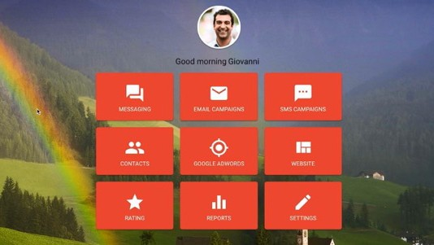
Through Digital Agent platform, we connect Generali, the agent and
client
8
Generali
Agents
Clients

Slide 9
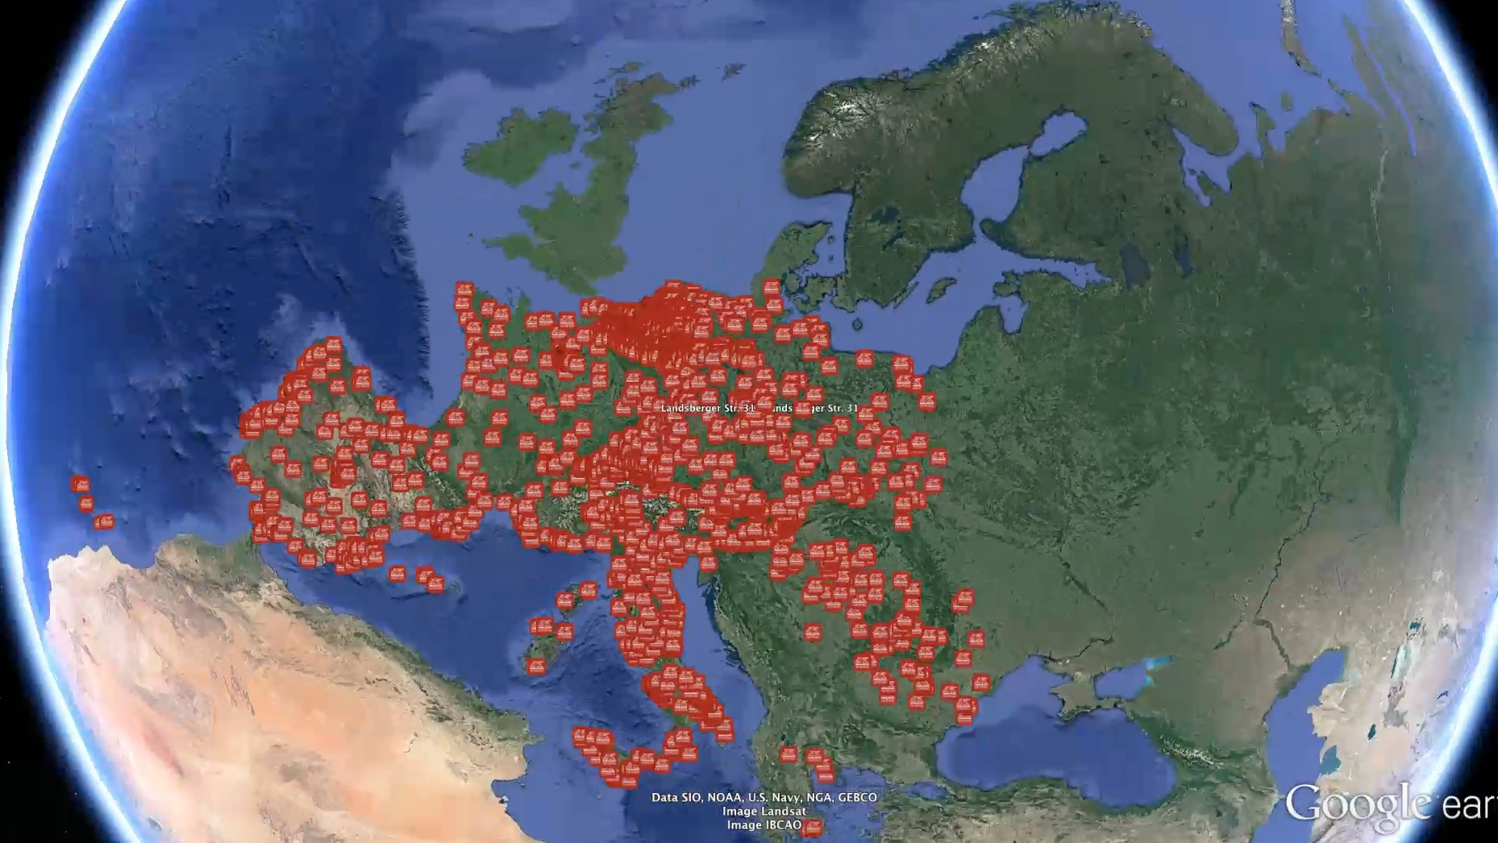
At scale
9

Slide 10

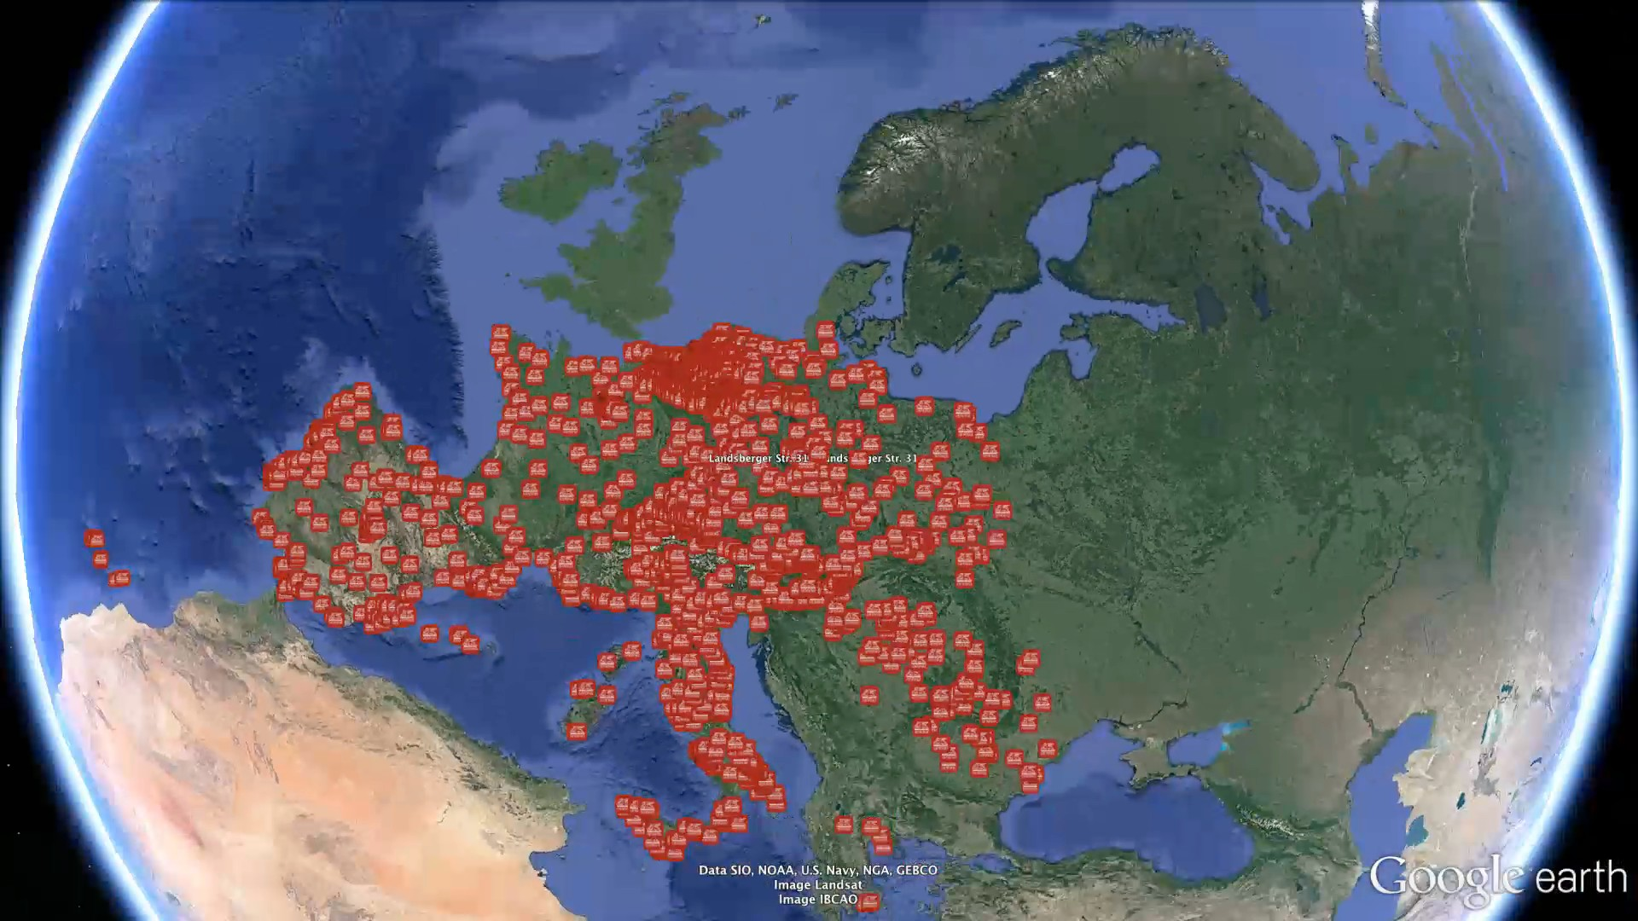
To leverage data analytics globally
10
Generali
INCREDIBLE INSIGHTS
DIGITAL INTERACTIONS
BIG DATA
Agents
Clients
SALES & MARKETI
NG HUDDLE 2017
Internal

