Slide 1
Healix Risk Rating A Verisk Analytics Business
May, 2017
Notes:
[click for next slide]

Slide 2
Verisk Analytics - Who We Are
A leading responsible data analytics company in pursuit of our customers’ most strategic opportunities
Provider of predictive analytics and decision support solutions to customers in specific vertical markets
Global company with offices and customers in nearly 80 countries around the world
Member of the S&P 500 and NASDAQ-100 indices
One of only 14 companies in the United States to appear on the Forbes World’s Most Innovative Companies and America’s Best Large Employers lists
Socially responsible company serving the long-term interests of our stakeholders
In February, 2017 Healix Risk Rating was acquired by Verisk Analytics.
Data Analytics Leader in Multiple Verticals
Insurance
Natural
Resources
Financial Services
Insight via Proprietary/ Unstructured Data
Analytics Framework
Digital Platforms
Global IT/Data
Center
Infrastructure
Recognition

Slide 3
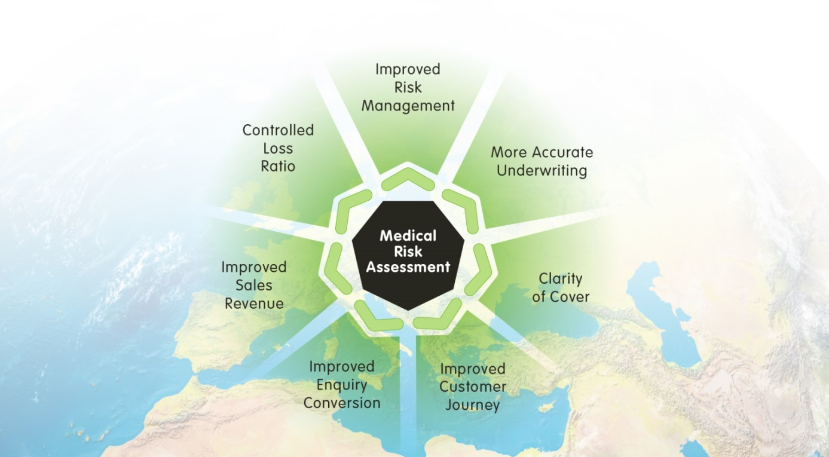
Healix Risk Rating - Automated Medical Risk Assessment
Over 17 million medical assessments performed annually
Automated Medical Risk Assessment solutions are integral to customer sales journey’s for global travel insurers
HRR Risk Assessment Solutions available for Travel, Health, Pet and Income protection markets.

Slide 4
Travel Insurance and Medical Risk
High-volume, Low-cost insurance
Emergency Medical Expenses are the largest contributor to claims costs
Travel insurance typically provides high cover limits
Past medical history is a key underwriting risk factor
Highly regulated industry with a requirement to ‘Treat Customers Fairly’
Legislation requires insurers to make individual assessments of risk
Not realistic to apply ‘traditional’ medical underwriting through a manual process
General exclusions are an ineffective means of avoiding claims related to pre-existing conditions.

Slide 5
Requirements of an Underwriting Solution
Direct interaction with customer
No expert medical “intervention”
Fully automated process
Consistent with distribution methodology
Quick and accurate medical risk assessment
Allows insurers to take an “educated” decision on risk acceptance
Instant, clear decision on price and extent of coverage.

Slide 6
The Challenge and The Solution
The Challenge
To stratify an individuals' medical risk for the travel insurer as quickly and accurately as possible
The Solution
Medical algorithmic database + technology
= The HRR Black Box
A global solution that has the power to increase sales, transform underwriting results and introduce operational efficiencies.

Slide 7
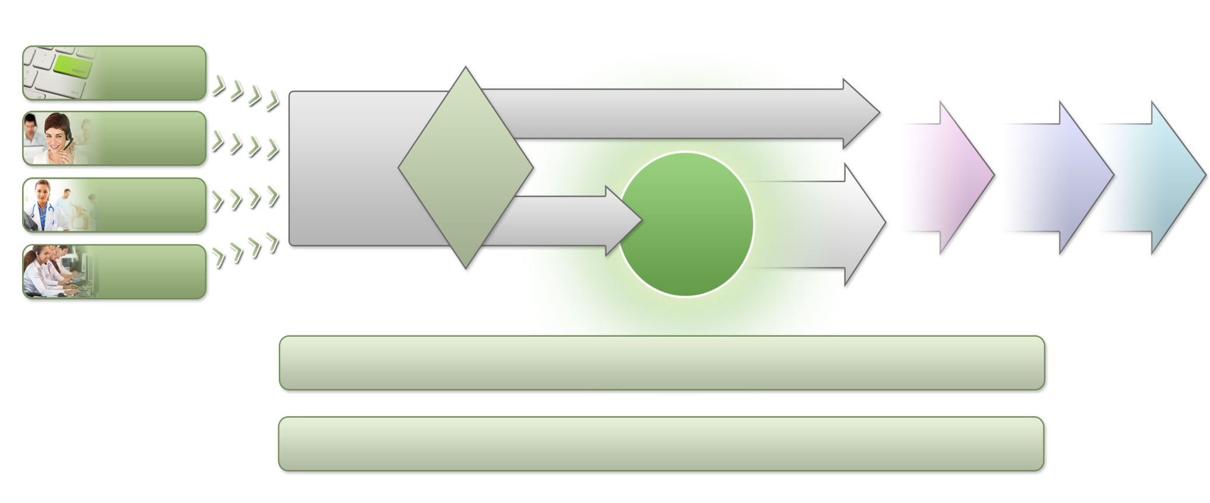
Travel Insurance and Risk Rating Journey
On-line
No Pre-existing Condition
Call Centre
SALES
Qualification
Policy
Administration
Claims
Management
Claims
Walk-in
HEALIX
RISK RATING
Standard
Pre-existing
Condition
Load
Brokers
Decline
Underwriting
Management Information

Slide 8
The Black Box Integration

Slide 9
The Customer Journey

Slide 10
The Customer Journey

Slide 11
The Customer Journey

Slide 12
Black Box Usage and Demonstration
Over 17 million screenings handled by Healix servers per annum
Acceptance by all UK travel insurers as risk assessment method of choice
Awarded Queens Award for Enterprise - Innovation
50,000 calls per annum to the Risk Rating Medical Support Team
HRR Travel Black Box deployed in five countries
Market leaders in UK, Australia, New Zealand and Spain
Medical data currently available in English, Bahasan, Japanese, Danish, French, Italian & Spanish
Translation tool facilitates future language expansion.

