Slide 1
P2P financial protection for affinity groups
Bertrand Favre – Co-founder
T: +33 (0)6 88 20 27 40
Email: bertrand.favre@yakman.com
Christophe Neves - Co-founder & CEO
T: +33 783 783 137
Email: christophe.neves@yakman.com

Slide 2

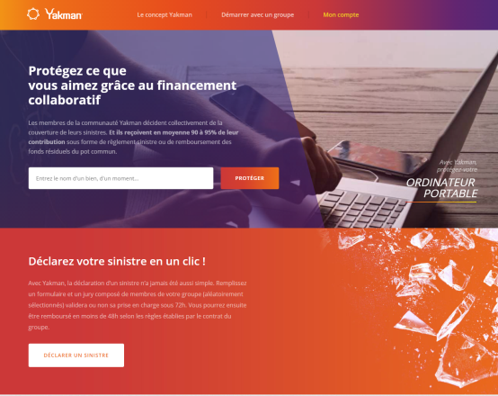
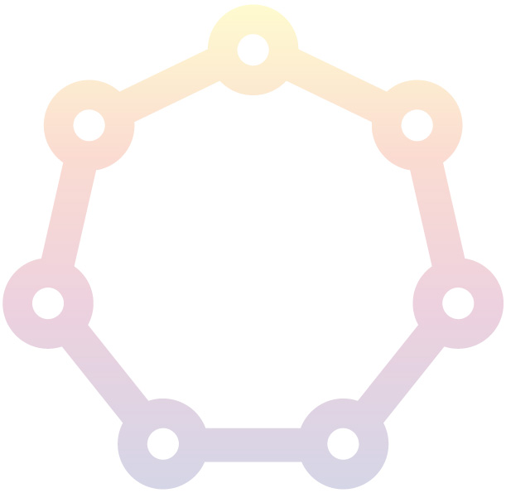
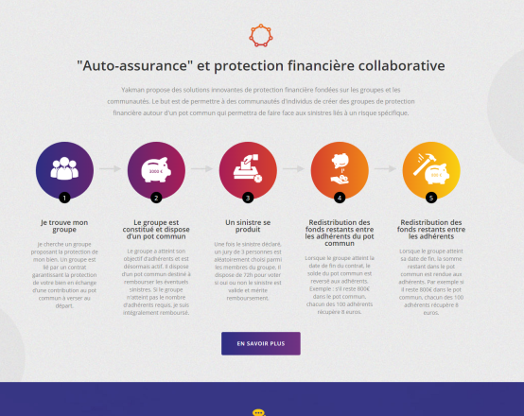
Executive summary.
Yakman is a solution provider dedicated to affinity groups (families, friends, people sharing common interests, customers of a company, members of an association…) which enables them to be « self-insured » and « self-managed » through an innovative scheme of financial and collaborative solidarity.
Yakman brings many innovations related to customer experience (Self-handling of claims and risk taking approach), science (behavioural economy) and IT (blockchain).
Yakman’s B2B2C business model is a mix between sharing economy and partnerships.
Yakman’s prototype and its first legal scheme are on line. We plan to enhance our value proposition by partnering with an insurer and to initiate our fundraising in order to execute our business plan. By 5 years from now, the annual premium earnings should reach €80M with a €1M EBITDA.

Slide 3


Value and customer centric proposition.
A solidarity and protective mechanism dedicated to groups of people sharing common interests for goods or moments of their lives.
How does a group work?
Example of group
Group manager | Individual/association/corporation They will manage their community | Association of photographs
Members threshold | 4 as a minimum to open a group No maximum required | 25
Warranty period | On demand | 02/05/17-01/05/17
Required contribution (premium) | A few hundreds euros as a maximum | 30€
Financial compensation | A fixed amount defined upfront – a few hundred euros < 2000 € | 250€
Cash-back | Remaining amount in the group is shared between members at the end of the warranty period (indicative amount) | 10€
(*) Amounts are for illustration.

Slide 4
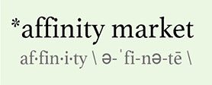
1. Our concept and ambition.
/ Pitch
Yakman is a solution enabler dedicated to groups sharing affinity and common interests (families, friends, people sharing common interests, customers of a company, members of an association…).
This innovative tool helps them in creating and joining tailor made protection products through an innovative collaborative process.
The mechanism builds a «self-insurance» solution which is self-managed for claims and provides a cash-back between members at the end of the period of cover of the group.
Our positioning is for customers interested in small-ticket insurance and affinity markets*. Our market estimation is ranging from €1-€2.5B for France to €11.5B in Europe.
 | Consumers with a common understanding based on similar qualities or characteristics Consumers with a relationship or causal connection, such as being a member of a group or community of interest
* PIMA definition

Slide 5
1. Our concept and ambition.
/ Our Vision
Yakman is the first self-insurance solution provider enabling groups to get self-insured and self-managed by :
  Creating tailor-made products,
  Increasing economic efficiency (90% ratio vs 60% to 10% ratio in some affinity market segments),
  Proposing a unique and end-to-end user experience: claims self-management by group members within 72h.
Our value proposition serves our ambition through the 3 following pillars:
  Product: provide our customers with tailor-made products directly designed by the end-user.
  Efficiency: increase efficiency ratio (ratio between the average amount paid by the insured customer and the expected efficiency) from 60% (sometimes 10% in some market segments) up to 90%.
  User experience: streamline and accelerate claims management between group members within a 72 hours process.
Our innovative financial protection solutions aim at changing the way customers manage risks.

Slide 6
2. How does it work?
/ Yakman’s financial solidarity mechanism
Yakman is a solution provider dedicated to groups sharing common interests (families, friends, people sharing common interests, customers of a company, members of an association…) which make them able to use a self-insurance mechanism for their specific needs. This scheme is built from the 3 following items:
The self-insurance mechanims is defined thanks to a Financial Protection Contract.
The use of a common pot mechanism to set it up in a secured scheme.
Claims self-management within the group to decide circumstances under which the solidarity of the group works.

Slide 7
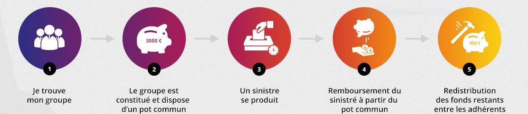
2. How does it work?
/A secured common pot
Enrollment period: a common pot is created and members can enroll to cover potential claims by paying the contribution.
During the period of cover, the funds from the pot are used to pay claims. If the pot is becoming empty,
Claims are self-assessed: for each claim, 3 members are chosen randomly in the group to assess through the digital platform whether the claim should be covered.
At the end of the period, the remaining funds are redistributed to the members.
Yakman brings a new tool for affinity groups…
  Digitalisation of the native forms of insurance.
  Cash-back and collaborative claims handling
  Tailor-made covers defined in a few clicks over the platform.
…with the technical support from Yakman.
All funds are deposited into « e-wallets » within a regulated European payment institution.

Slide 8

2. How does it work?
/An efficient value proposal for customers
The business model is at the crossroad of the sharing economy (a commission paid for money-in) and the B2B2C approach (we target the group manager who will manage/animate his community).
Commissions are paid only if the group is activated.
IPT and insurance premium
Yakman Commission
Group manager commission
Portion of the member contribution feeding the common pot to pay for claims and the cash-back

Slide 9
2. Yakman bring strong innovations.
/ A disruption
Yakman is a projects with innovation in 3 different areas
  Use of behavioural economy :
    With the involvement of strong communities, we expect an improvement of the claims experience.
    A Phd will study the main drivers of the influence of communities in the risk experience (and prevention) and derive best practices.
01
SCIENCE
  New way to manage risk within a community.
  Claims self-management within a group.
  Ability to design tailor-made cover in a few clicks.
02
03
  Use of blockchain* to :
    Store information of a group.
    Reinforce the uniqueness of the information of the Financial
    (* at a later stage)
USE
TECHNICAL
Innovations brought by Yakman are unique and the project has been recognised by the French ecosystem (Finance Innovation).

Slide 10


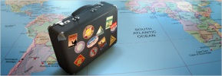


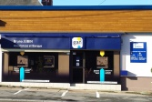
3. A business model at the crossroad between sharing economy and B2B2C
/ A sales approach as B2A2C – business to affinity to consumers
The sales approach targets the group manager
2 types of segments requires specific methods :
  Atomised segment (in the initial development phase of Yakman):
    Individuals or small entities with a common interest.
    Direct marketing, digital marketing, social networks.
    Quick and rather limited ROI.
  Organized segment
    Group managers are Professional entities (large associations, corporations)
    Dedicated sales workforce
    Later and larger return on investment
Initial targeted universes:
  Electronic goods: protection for smartphones, tablets, laptops
  Colleges/Tution : a lump sum is paid in case the student is unable to complete his year of studies due to an external cause.
  Travel : Travel cancellation
  Classic cars: in case of an accident, an amount defined upfront is provided
  Sport: to protect the equipment linked with the practising of sports.
  Insurance agents/brokers: to create new products for protection

Slide 11





1. Présentation du concept Yakman et de son ambition.
/ Marché & Concurrence
3. A business model at the crossroad between sharing economy and B2B2C
/ Differences with other P2P approaches
Yakman has a cash-back mechanism as a P2P player and offers other significant add-ons:
Behavioural Economy: To our knowledge, Yakman is the only European player making the link between the theoretical knowledge and the best practices of this science a little like . Communities are the key element is our approach to better manage the risks.
Self claims management process for a better customer experience (claims are by peers and in a fast way)
In terms of risks, we have developed an horizontal approach which is innovating compared to our peers:
Approach | Vertical | Horizontal
Risks considered | Standard risks with high limits (Homeowner, Auto, Health) | Niche and tailor-made protection Cover without third party
Mechanism | Common Pot + Traditional insurance contract with high deductible | Common Pot Protection within a group / Insurance contract only to protect a potential lack of funds in the common pot
Notes:
Notes :
Positionnement complémentaires et partenarial des assureurs :
Complément de leurs offres
Bac à sable
Solutions pilotes
Assuré responsable
Accès facilité aux produits d’assurance et de crédit
--
Une proposition de valeur alternative et complémentaire au positionnement des assureurs…
…que nous ciblons comme partenaires de développement :
service complémentaire à leur offre (« l’affinitaire simplifié pour les non-professionnels »)
bac à sable
solutions pilotes
assuré responsable
accès facilité aux produits d’assurance et de crédit

Slide 12





3. Yakman brings strong innovations.
/ A team to deliver the project
2 co-funders with a perfect match in terms of skills
    A risk expert (certified actuary and CERA) with 20 years in insurance companies (AXA, AIG and Allianz). Experience in actuarial and underwriting in a B2B2C context and in an international environment.
      Group Actuarial and Underwriting Services Director – Allianz Global Assistance
      Senior Vice President – Head of Capital Modelling AIG Europe
    A sales and marketing profile (HEC). Expert in digital and direct marketing. After having set-up an Internet company, he joined the digital marketing division of Allianz.
      B2C Business Developer within the Digital division.
      CEO Executive Assistant
Partnerships within the Fintech ecosystem
Lemonway as the Payment institution provider
A leading legal firm for the legal analysis
Economix a research center in economics operated by the CNRS (National Centre for Scientific Research) and the University of Paris Ouest Nanterre La Défense.
Pôle Finance Innovation (French hub for innovation in Finance)
An advisory board:
      A first member: a former CEO of a niche insurance Company for Continental Europe.
    Our ambition is to reach €80M of annual contribution in 5 years in France and to roll out the model in Europe.

Slide 13
Yakman is a solution provider dedicated to affinity groups (families, friends, fans, customers of commercial entities, members of associations, etc.), which makes them able to get "self-insured" and to manage claims process through an innovative model relying on financial and collaborative solidarity.

