Slide 1
SENTIANCE CONTEXTUAL INTELLIGENCE
POWERING THE INTERNET OF YOU

Slide 2
Sentiance analyzes sensor data to understand human behavior & context
CONTEXT INTELLIGENCE
enabling the Internet of You
Connected – Contextual – Assisting

Slide 3
Unlock the power of IOT data
1
2
3
^{COLLECT SENSOR DATA}
^{UNLOCK REAL-TIME CONTEXT}
ENABLE CONTEXT-AWARE ASSISTANCE
Using IOT sensor data to infer real-time context and behavioral patterns (smartphones, in-home appliances, wearables).
Applying behavioral modelling and machine learning to make sense of the data by attributing situational context and behavioral routines.
Enabling companies to enrich their customer data and provide context-aware engagement and services

Slide 4
Sensor range
on the go
in home
body
Notes:
At Sentiance we use IOT sensor data to observe and interpret human behavior and understand real-time context.
We work with a range of sensory devices, with mobile being our primary focus.

Slide 5
CONTEXT
defined
LAYER 3
SEGMENTS
WHO
WORK/LIFE
COMMUTING & MOBILITY
SHOPPING & ENTERTAINMENT
FOOD
SOCIALNESS
LEISURE
LAYER 2
MOMENTS
WHY
COMMUTE
LUNCH
DINING OUT
SHOPPING
ARRIVING/LEAVING HOME, WORK,..
SPORT
WORK
KIDS PICK-UP
CULTURAL EVENT
LAYER 1
WHAT
WHERE
WHEN
EVENTS
DRIVING (CAR)
TRAIN/BUS/TRAM
WALKING
RUNNING
BIKING
HOUSE
IRR PLACE
OFFICE
IN KITCHEN
STATIONARY
SEMANTIC TIME (eg MORNING)
WEEKDAY/WEEKEND
RESTAURANT/SHOP/VENUE

Slide 6
Moments & segments
Work/Life
Home
Work
Family
Social
Leisure
Entertainment
Dining&Wining
Well-Being
Shopping
Mobility
Transport
Commute
Travel
Driving

Slide 7
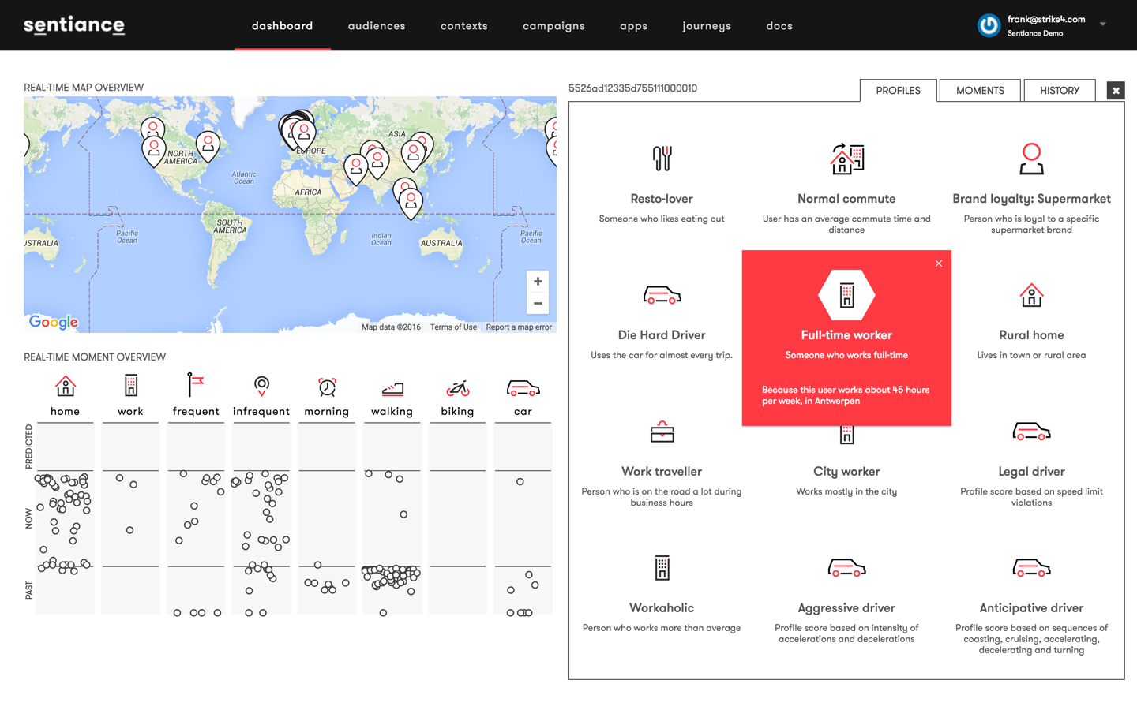

Slide 8
Unlocking the Value from Context
Enriched customer insights (KYC) Enrich account data & customer profiles with behavioral and contextual insights
Customer journey mapping Contextualize the real-world customer journey and discover the key moments of truth
Real-time personalization Tune engagement and experience to real-time context and behavioral profile
Behavioral coaching Track, analyze and coach behavioral change
Data intelligence & monetization Aggregate population insights into anonymized data sets

Slide 9
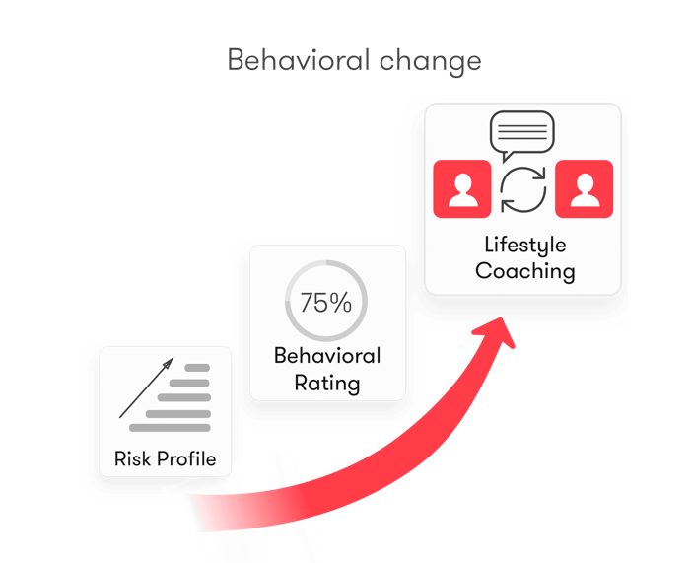
Lifestyle-based Insurance
USER-BASED CAR INSURANCE
Auto UBI & driver coaching leveraging driver profiling
From pay-as-you-drive to pay-how-you-drive
LIFESTYLE-BASED HEALTH & LIFE INSURANCE
Health Insurance premiums based on healthy lifestyle
Well-being monitoring & coaching
HOME INSURANCE & ASSISTED LIVING
Home activity monitoring & real-time risk prevention
Assisted living & anomaly detection/alerts
ON-DEMAND INSURANCE
Contextual insurance based on ad-hoc needs
Notes:
In summary, a broad range of commercial use cases, with a good subset already well under way in terms of proof of concept validation.

Slide 10
Technology Stack & Architecture
IoT gateway
SPEED LAYER
CONTEXT STORE
FIREHOSE
DMP
CRM
…
DATA
INGESTION
MICRO SERVICES
API
REPLICATE
BATCH LAYER
PROFILE STORE
API - PULL
CLOSED LOOP
(Feedback, Attribution, Re-enforcement, User attributes)

